Slide 1
Waves and Sound

Slide 2
Vibration: the periodic motion of an object about an equilibrium point. It depends on the medium’s molecular and mechanical structure, its density, and its temperature.
Mechanical wave: the transfer of energy through a medium due to vibration.
Medium: the material that permits the transmission of energy through vibrations

Slide 3
Types of Mechanical Waves
1. Transverse Waves:
The diagram shows waves being produced on a rope that has
one end tied tightly to a post.
(a) Where does the energy that produces the wave come from?
(b) In which direction is the wave travelling?

Slide 4
A transverse wave: occurs when particles of the medium vibrates perpendicular to its wave direction.
Crest: the maximum point.
Trough: the minimum point.

Slide 5
Amplitude: the maximum displacement of a wave from its equilibrium point
A cycle: is a complete sequence of motion that repeats itself.
Wavelength (λ): the length in metres (m) of one cycle (the distance between two similar points in cycles) , given the symbol lambda.is

Slide 6
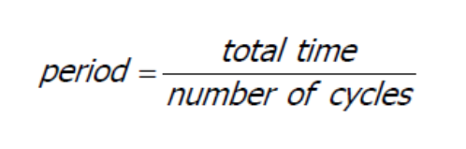
The period (T): is the time of one cycle and is measured in seconds (s).

Slide 7
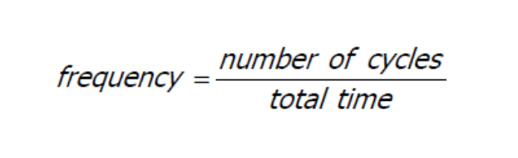
Frequency (f) : the number of cycles in one second. It is measured
in cycles per second. This unit is named hertz (Hz) .

Slide 8
In phase: when two identical waves pass through the rest position at the same time – otherwise they are vibrating out of phase.
Phase shift: a shift of an entire wave along the x-axis with respect to an
otherwise identical wave.

Slide 9
Example:
List all pairs of points that are in phase.

Slide 10
Example:
Use the given Figure to find:
a) the wavelength.
b) the period.
c) the amplitude.
d) the frequency.
4 m
8 s
5 cm
1/8 Hz

Slide 11
Types of Mechanical Waves
2. A longitudinal Wave
occurs when particles of the medium vibrates parallel to the wave direction.

Slide 12
Types of Mechanical Waves
Sound is an example of longitudinal waves.
Longitudinal waves are treated as a transverse wave because it is easier to figure its characteristics.

Slide 13
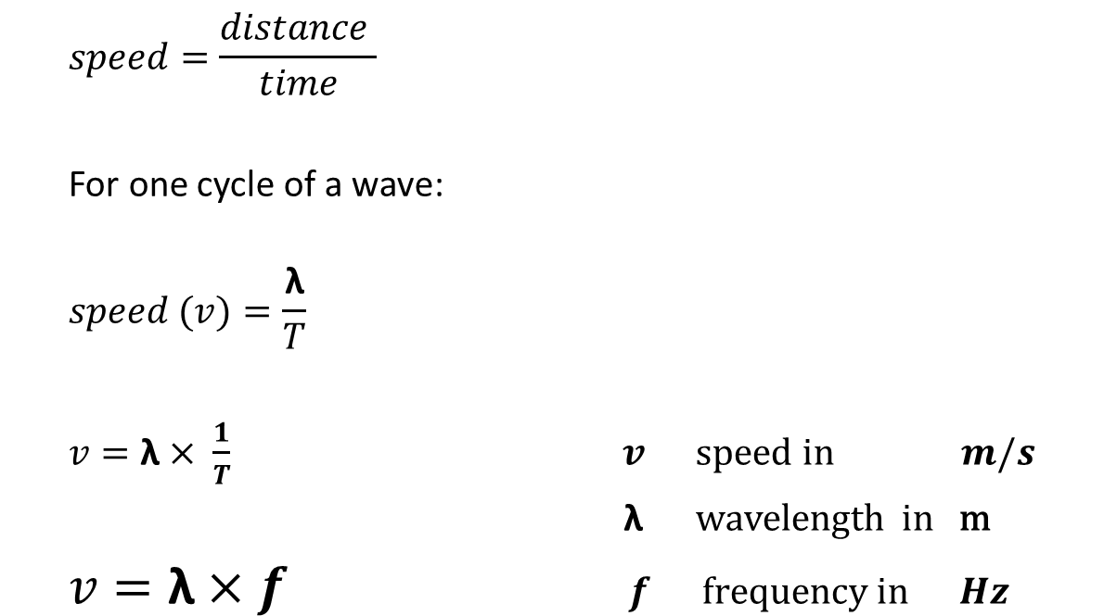
Wave speed:
$$speed=\frac{distance }{time}$$
For one cycle of a wave:
$$speed (v)=\frac{\text{λ}}{T}$$
$v=\text{λ}× \frac{1}{T}$ $v speed in m/s$
λ wavelength in m
$v=\text{λ}×f$ $f frequency in Hz$

Slide 14
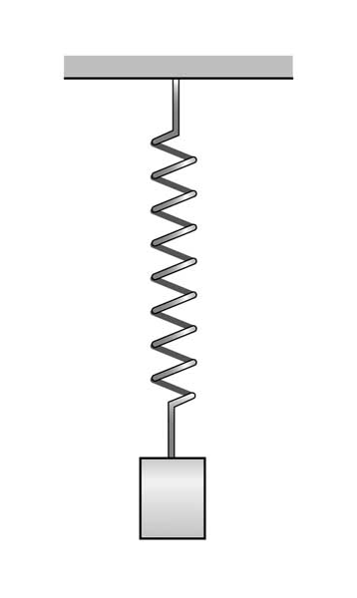
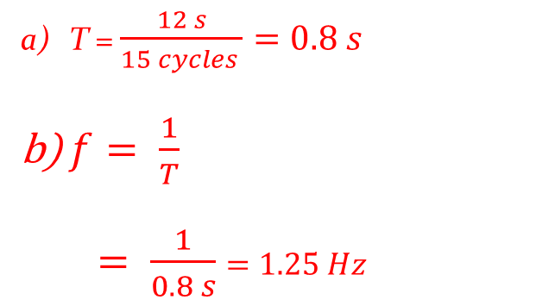
Example:
A mass attached to the end of a spring vibrates 15 times in 12 s.
Calculate:
the period of the vibration.
the frequency
T = $\frac{12 s}{15 cycles }=0.8 s$
$f= \frac{1}{T}$
$= \frac{1}{0.8 s}$ $=1.25 Hz$

Slide 15
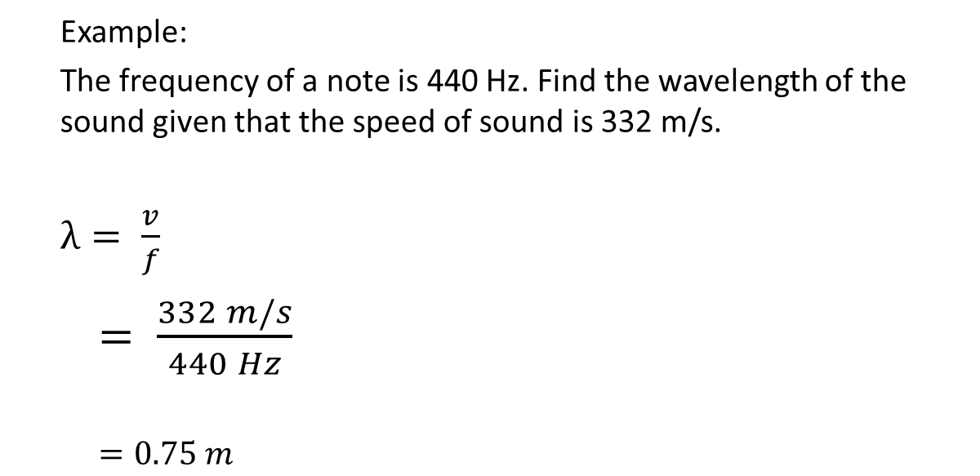
Example:
The frequency of a note is 440 Hz. Find the wavelength of the sound given that the speed of sound is 332 m/s.
$λ= \frac{v}{f}$
$= \frac{332 m/s}{440 Hz}$
$=0.75 m$

Slide 16
Speed of sound in different media:
Sound can be transmitted through any medium – gas, liquid, or solid depending on properties of medium temperature, density, …)
(solid > liquid > gas)
waves travel faster in hotter gases than in cooler gases

Slide 17
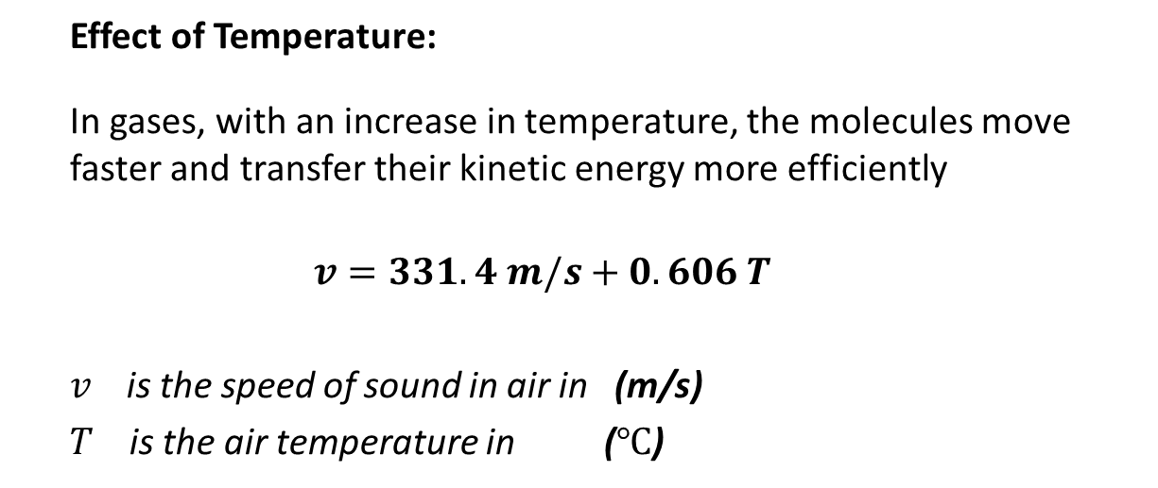
Speed of sound in Air and Temperature
Effect of Temperature:
In gases, with an increase in temperature, the molecules move faster and transfer their kinetic energy more efficiently
$$v=331.4 m/s+0.606 T$$
$v$is the speed of sound in air in (m/s)
$T$ is the air temperature in ($℃$)

Slide 18
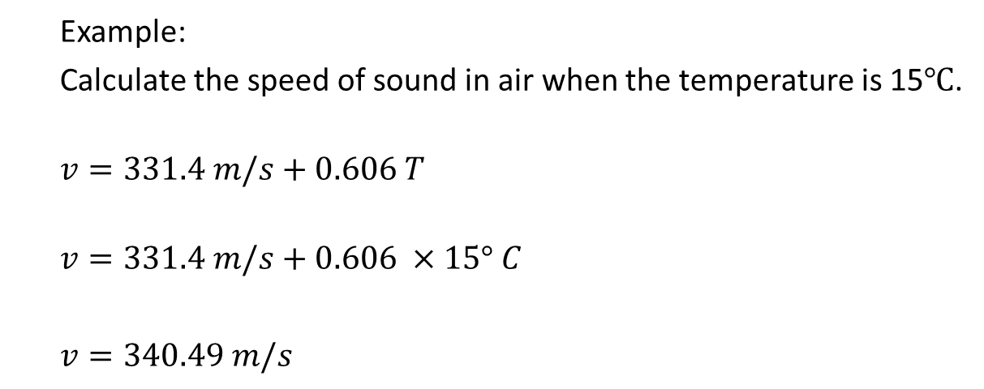
Example:
Calculate the speed of sound in air when the temperature is 15$℃$.
$$v=331.4 m/s+0.606 T$$
$$v=331.4 m/s+0.606 ×15° C$$
$v=340.49 m/s$

Slide 19
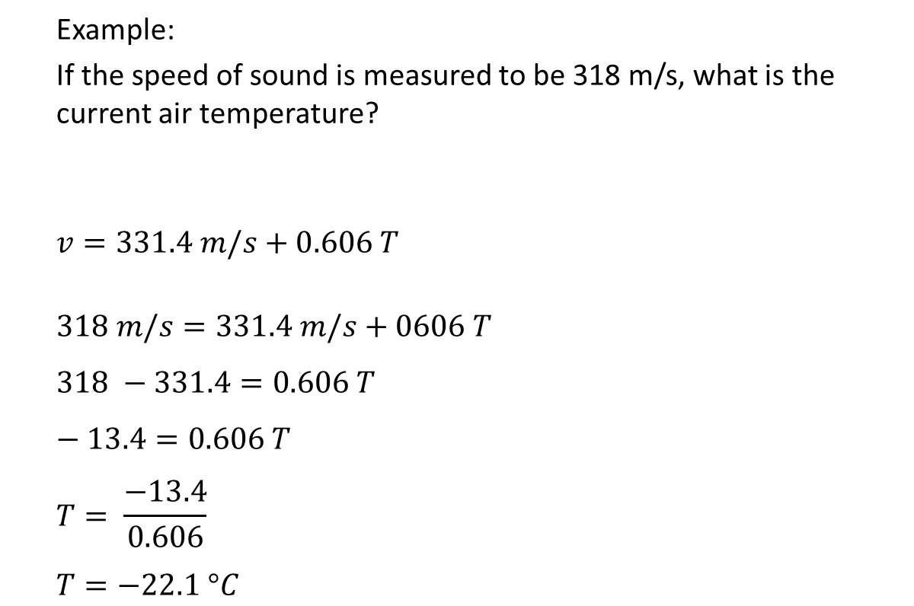
Example:
If the speed of sound is measured to be 318 m/s, what is the current air temperature?
$$v=331.4 m/s+0.606 T$$
$$318 m/s=331.4 m/s+0606 T$$
$$318 −331.4=0.606 T$$
$$− 13.4=0.606 T$$
$$T= \frac{−13.4}{0.606}$$
$$T=−22.1 °C$$

Slide 20
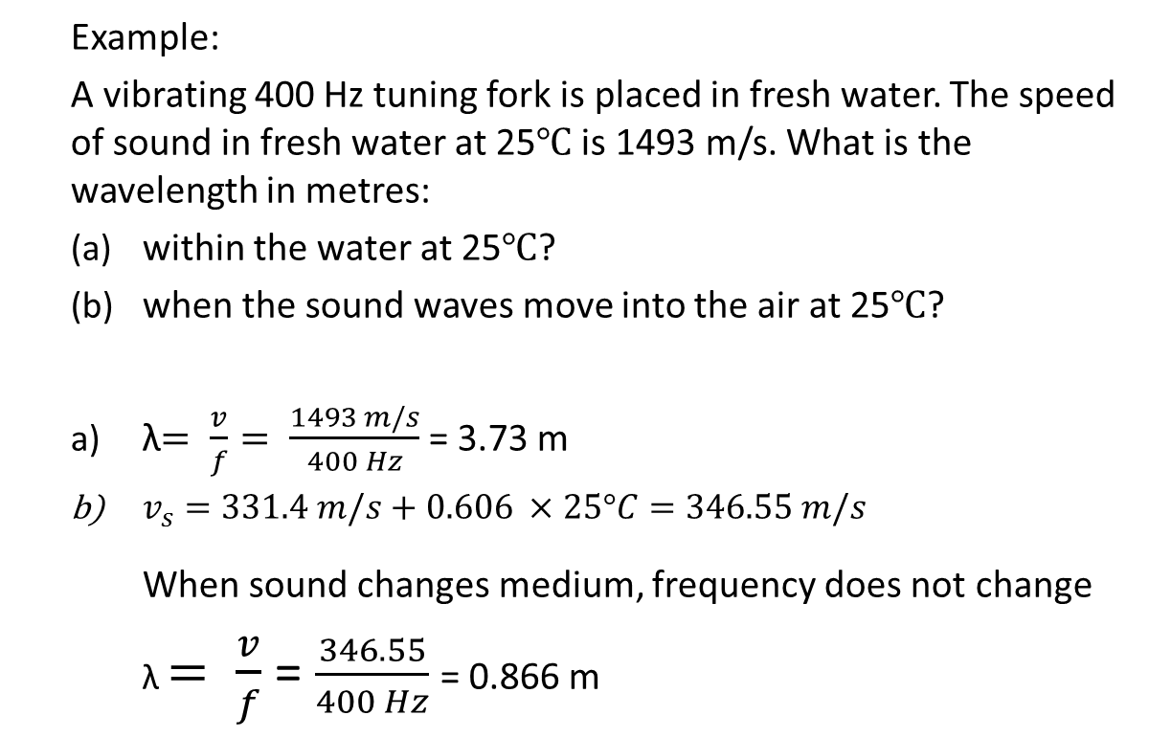
Example:
A vibrating 400 Hz tuning fork is placed in fresh water. The speed of sound in fresh water at 25$℃$ is 1493 m/s. What is the wavelength in metres:
within the water at 25$℃$?
when the sound waves move into the air at 25$℃$?
λ$= \frac{v}{f}= \frac{1493 m/s}{400 Hz}$ = 3.73 m
$v_{s}=331.4 m/s+0.606 ×25°C=346.55 m/s$
When sound changes medium, frequency does not change
λ $= \frac{v}{f}$ = $\frac{346.55}{400 Hz}$ = 0.866 m
H. W questions # 1 – 6 on page 380,
# 1 – 9 on page 384, and
# 1 - 6 on page 386 of the textbook

Slide 21
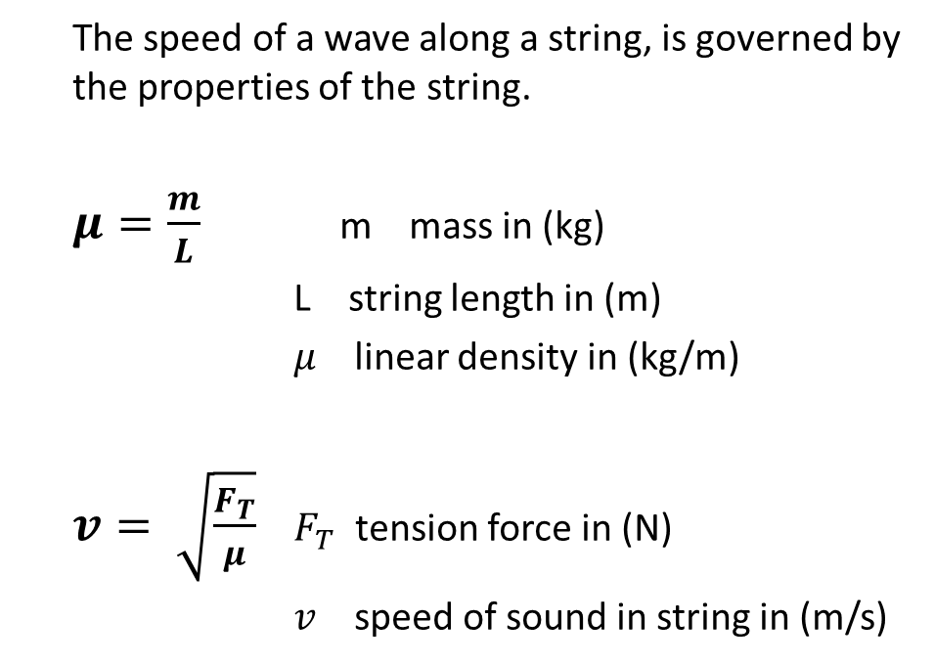
Linear Density and Tension
The speed of a wave along a string, is governed by the properties of the string.
$μ=\frac{m}{L}$m mass in (kg)
L string length in (m)
$μ$ linear density in (kg/m)
$v= \sqrt{\frac{F_{T}}{μ}}$ $F_{T}$ tension force in (N)
$v$ speed of sound in string in (m/s)

Slide 22
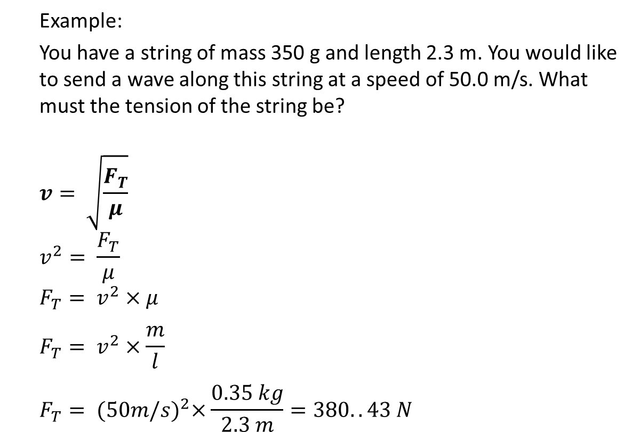
Example:
You have a string of mass 350 g and length 2.3 m. You would like to send a wave along this string at a speed of 50.0 m/s. What must the tension of the string be?
$$v= \sqrt{\frac{F_{T}}{μ}}$$
$$v^{2}= \frac{F_{T}}{μ}$$
$$F_{T}= v^{2}×μ$$
$$F_{T}= v^{2}×\frac{m}{l}$$
$$F_{T}= {(50m/s)}^{2}×\frac{0.35 kg}{2.3 m}=380..43 N$$

Slide 23
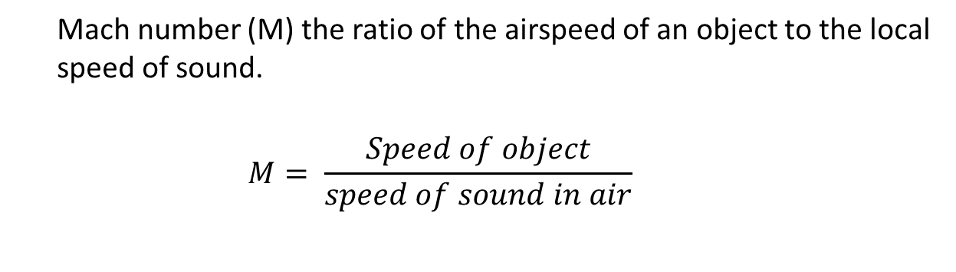
Mach Number (M):
Mach number (M) the ratio of the airspeed of an object to the local speed of sound.
$$M= \frac{Speed of object}{speed of sound in air}$$

Slide 24
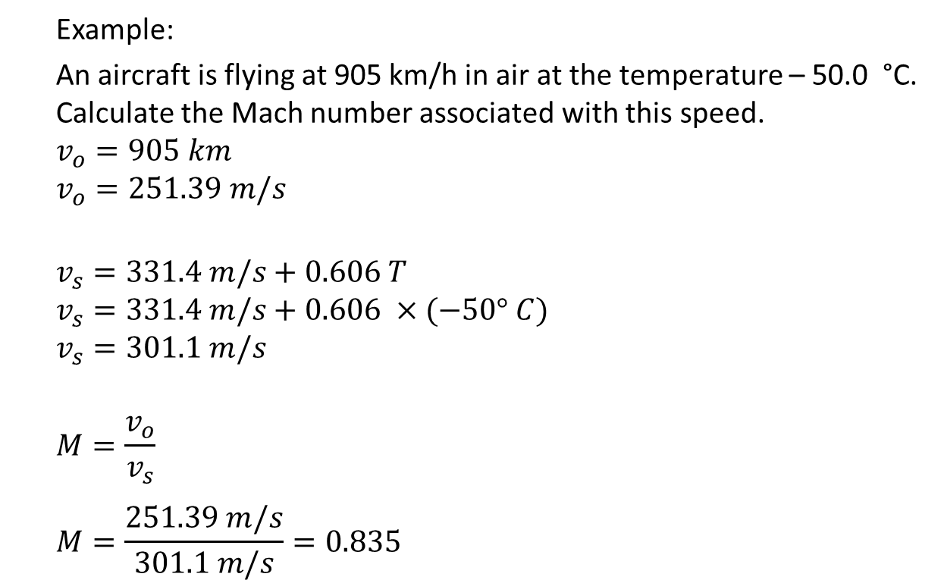
Example:
An aircraft is flying at 905 km/h in air at the temperature – 50.0 °C. Calculate the Mach number associated with this speed.
$$v_{o}=905 km$$
$$v_{o}=251.39 m/s$$
$$v_{s}=331.4 m/s+0.606 T$$
$$v_{s}=331.4 m/s+0.606 ×(−50° C)$$
$$v_{s}=301.1 m/s$$
$$M=\frac{v_{o}}{v_{s}}$$
$$M=\frac{251.39 m/s}{301.1 m/s}=0.835$$

Slide 25
Example:
You hear the sonic boom sound of a plane after 3.40 s. The plane is travelling at Mach 2.2 and the average air temperature for the sound is 15°C. How far is the plane from you?
H W questions # 1 – 7 on page 391, and
# 1 – 11 on page 397 of the textbook.
# 44, 45, 46, and 48 on page 475 of the package.

Slide 26
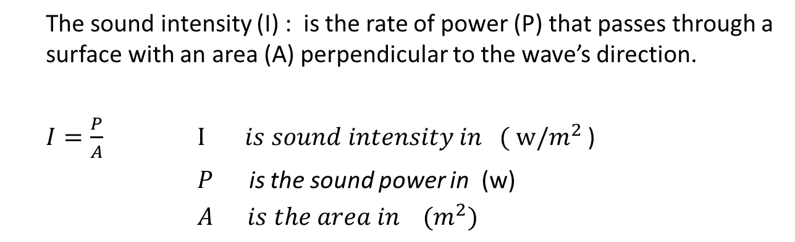
Sound Intensity
Loudness describes how humans perceive sound energy.
Loudness depends on a quantity called sound intensity (I).
The sound intensity (I) : is the rate of power (P) that passes through a surface with an area (A) perpendicular to the wave’s direction.
$I=\frac{P}{A} I is sound intensity in ( w/m^{2}$ )
$P$ is the sound power in (w)
$A is the area in (m^{2})$

Slide 27
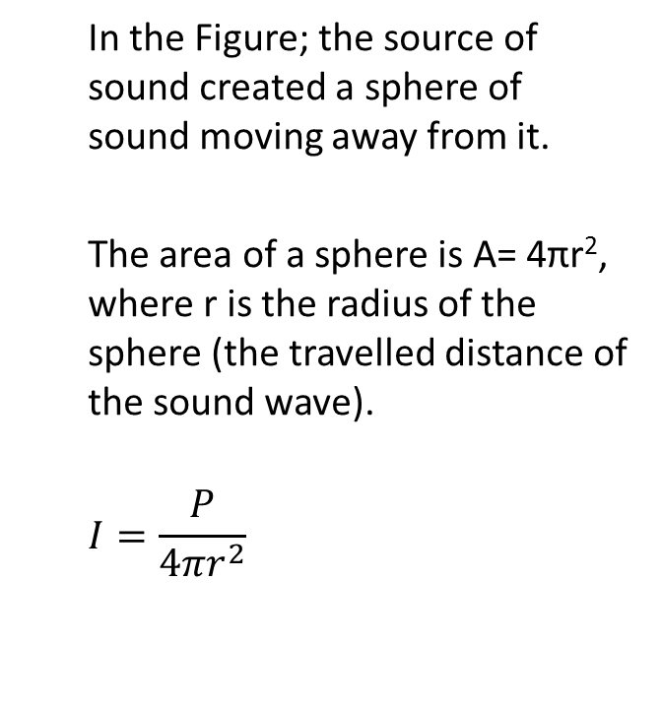
Sound Intensity
In the Figure; the source of sound created a sphere of sound moving away from it.
The area of a sphere is A= 4πr², where r is the radius of the sphere (the travelled distance of the sound wave).
$$I=\frac{P}{{4πr}^{2}}$$

Slide 28
Example:
A helicopter hovers overhead during an airshow, causing sound waves to emanate uniformly. If the first listener is 700 m away and the second listener is 1000 m away, by how much has the intensity level of the sound decreased when it reaches listener 2?

Slide 29
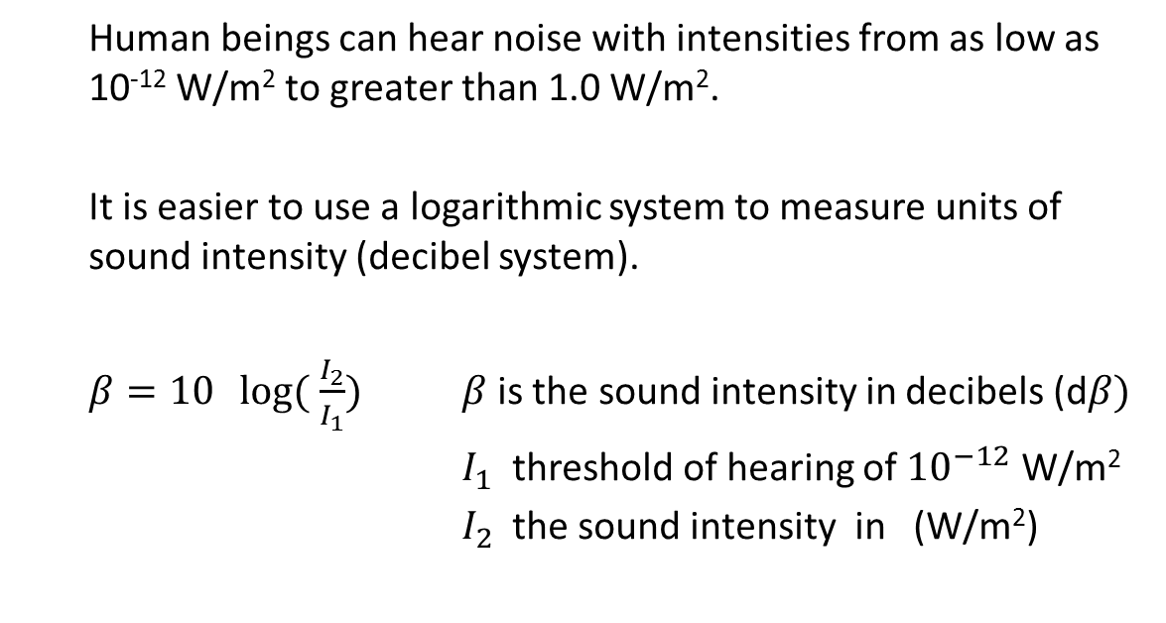
The Decibel System
Human beings can hear noise with intensities from as low as 10⁻¹² W/m² to greater than 1.0 W/m².
It is easier to use a logarithmic system to measure units of sound intensity (decibel system).
$β=10\log{( \frac{I_{2}}{I_{1}})}$ $β$is the sound intensity in decibels (d$β)$
$I_{1}$ threshold of hearing of ${10}^{−12}$ W/m²
$I_{2}$the sound intensity in (W/m²)

Slide 30
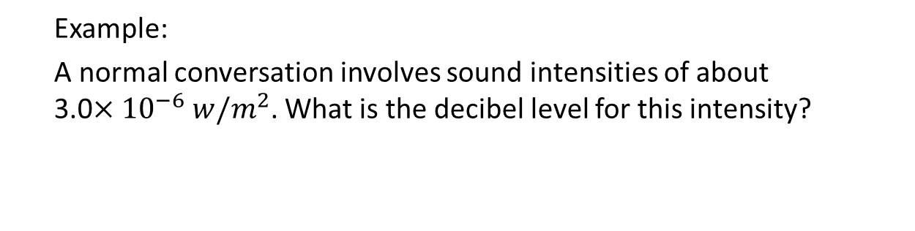
Example:
A normal conversation involves sound intensities of about 3.0$×{10}^{−6} w/m^{2}$. What is the decibel level for this intensity?

Slide 31
Example:
A thief coughs with an intensity of 2.35 × 10 ^{–7} W/m². The theft alarm is sensitive to an intensity of 1.0 × 10^{–10} W/m² and will ring if the detected sound is 30 dB greater than its detection threshold. Will the thief’s cough be detected?

Slide 32
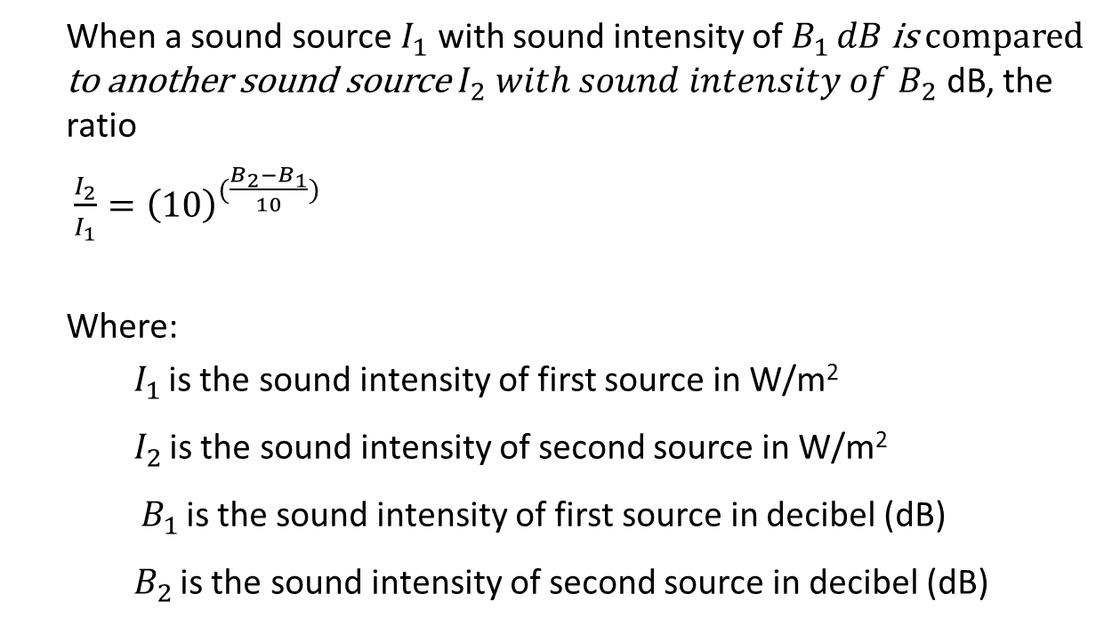
Comparing Sounds intensity in decibels
When a sound source $I_{1}$ with sound intensity of $B_{1 }dB$ is compared to another sound source $I_{2} with sound intensity of B_{2}$ dB, the ratio
$\frac{I_{2}}{I_{1}}={\left(10\right)}^{(\frac{B_{2}−B_{1}}{10})}$
Where:
$I_{1 }$is the sound intensity of first source in W/m²
$I_{2 }$is the sound intensity of second source in W/m²
$B_{1 }$is the sound intensity of first source in decibel (dB)
$B_{2 }$is the sound intensity of second source in decibel (dB)

Slide 33
Example:
How many times greater in intensity is the threshold of pain (120 dB) than:
a) normal conversation (60 dB)?
b) a rock concert (110 dB)?
H W Questions # 49, 51, 52, 54, 57, 60, and 61 on page 475-476 of the package.

Slide 34
The Doppler Effect
As the moving siren passes a stationary detector, the detector hears a change in the siren’s sound.
The sound waves are compressed as the siren approaches the detector and more spread out as the siren passes the detector.
Car Horn
Doppler Effect Explanation

Slide 35
The Doppler Effect
a stationary source emits sound waves with a particular frequency.
If the source of sound is moving, In front of the moving source, the sound has a shorter wavelength and a higher frequency.
Behind the moving source, the sound has a longer wavelength and a lower frequency.

Slide 36
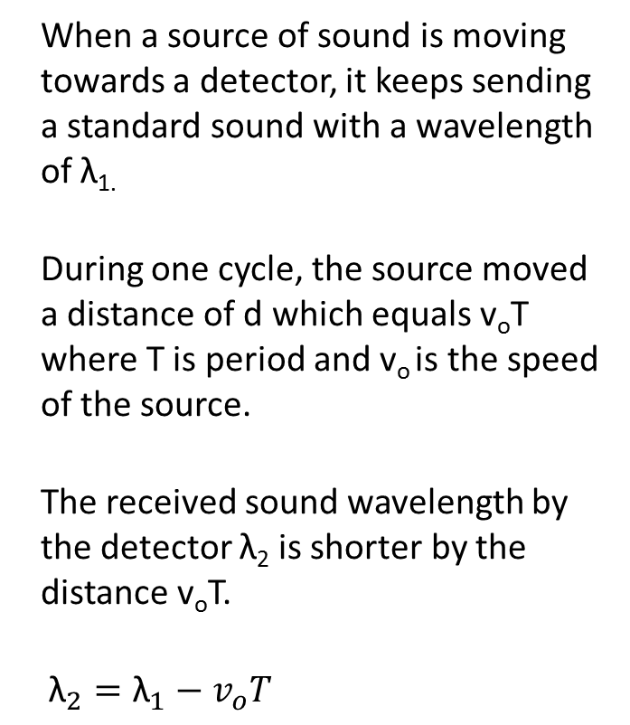
When a source of sound is moving towards a detector, it keeps sending a standard sound with a wavelength of λ_{1.}
During one cycle, the source moved a distance of d which equals v_{o}T where T is period and v_{o} is the speed of the source.
The received sound wavelength by the detector λ₂ is shorter by the distance v_{o}T.
${\text{λ}}_{2}={\text{λ}}_{1}−v_{o}T$
Vo T

Slide 37
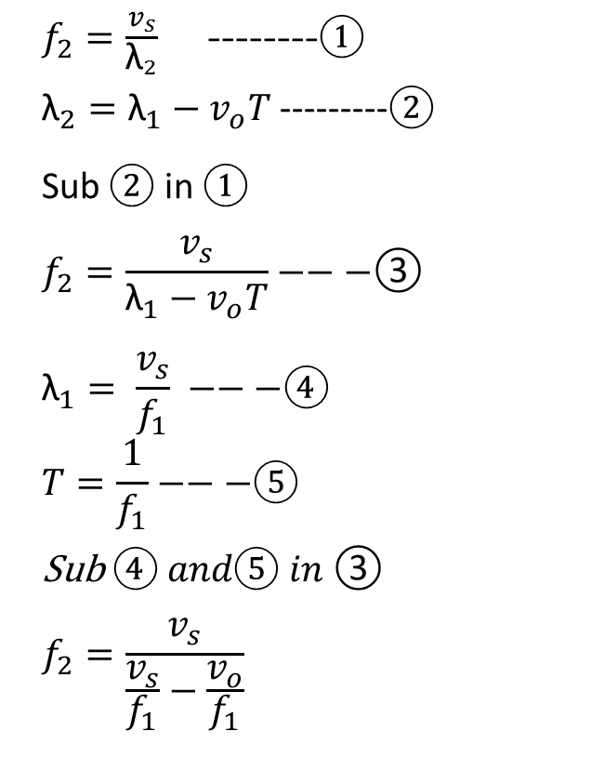
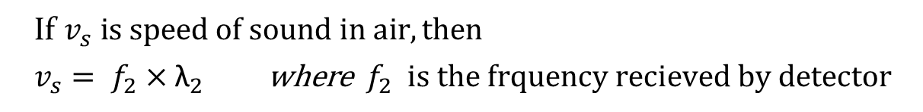
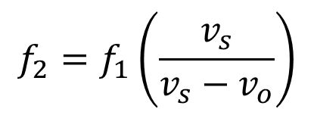
If $v_{s} is speed of sound in air, then$
$v_{s}= f_{2}×{\text{λ}}_{2}$where $f_{2} is the frquency recieved by detector$
$f_{2}=\frac{v_{s}}{{\text{λ}}_{2}}$ --------①
${\text{λ}}_{2}={\text{λ}}_{1}−v_{o}T$ ---------②
Sub ② in ①
$$f_{2}=\frac{v_{s}}{{\text{λ}}_{1}−v_{o}T}−−−\text{③}$$
$${\text{λ}}_{1}= \frac{v_{s}}{f_{1}} −−−④$$
$$T=\frac{1}{f_{1}}−−−⑤$$
Sub $④ and⑤ in \text{③}$
$$f_{2}=\frac{v_{s}}{\frac{v_{s}}{f_{1}}−\frac{v_{o}}{f_{1}}}$$
Vo T
$$f_{2}=f_{1}\left(\frac{v_{s}}{v_{s}−v_{o}}\right)$$

Slide 38
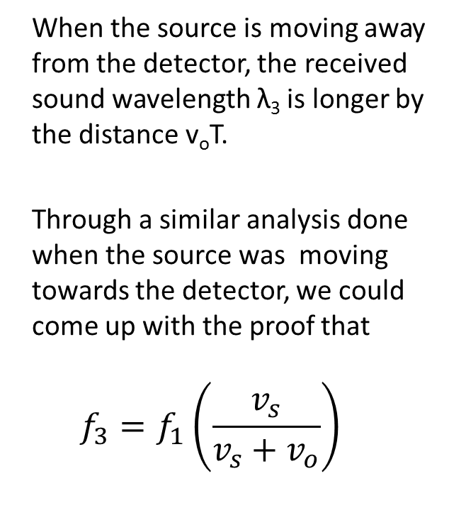
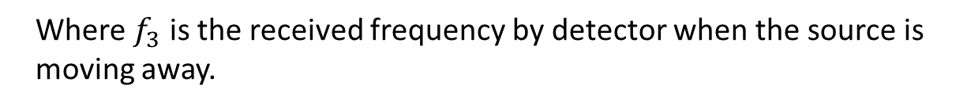
When the source is moving away from the detector, the received sound wavelength λ₃ is longer by the distance v_{o}T.
Through a similar analysis done when the source was moving towards the detector, we could come up with the proof that
$$f_{3}=f_{1}\left(\frac{v_{s}}{v_{s}+v_{o}}\right)$$
Where $f_{3}$ is the received frequency by detector when the source is moving away.

Slide 39
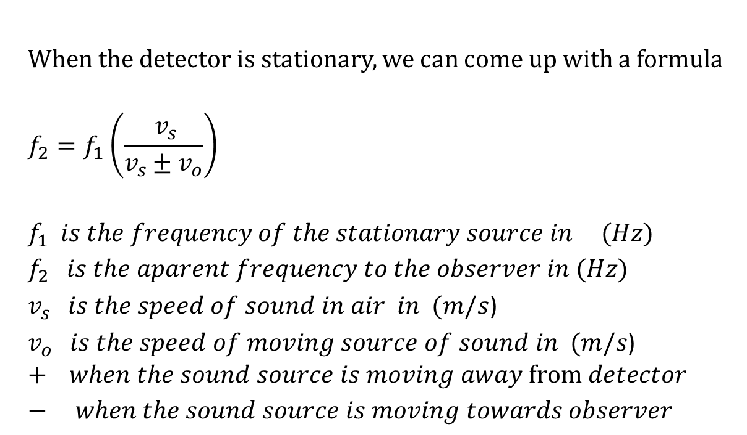
When the detector is stationary, we can come up with a formula
$$f_{2}=f_{1}\left(\frac{ v_{s}}{v_{s}±v_{o}}\right)$$
$$f_{1} is the frequency of the stationary source in (Hz)$$
$f_{2} is the aparent frequency to the observer in (Hz)$
$v_{s} is the speed of sound in air in (m/s$)
$v_{o} is the speed of moving source of sound in (m/s$)
$$+ when the sound source is moving away from detector$$
$− when the sound source is moving towards observer$

Slide 40
Example:
The Batmobile is approaching Batgirl at a speed of 140 km/h while
sounding its horn. Calculate the apparent frequency of the horn heard by Batgirl if the sound has a frequency of 500 Hz. Assume a speed of sound of 344 m/s.

Slide 41
Example:
How fast is a car moving in km/h and in what direction if the frequency of its horn drops from 900 Hz to 875 Hz, as heard by a stationary listener? The air temperature is 0°C.
H W Questions # 1 – 7 on page 435 of the textbook and
Questions # 64, 66, 67, and 69 on pages 476-477 of the package

